Slide 1
Introduction to Genealogy and Family History
Methods, Tools, and Best Practices
Notes:
This presentation was automatically generated by PowerPoint Copilot based on content found in this document:

Slide 2

Introduction to Genealogy and Family History
Genealogy is a Personal Journey
  Solving family mysteries
  Building a comprehensive family tree
Motivations for Research
  Joining lineage societies
  Discovering ancestral origins
Family Research is a Quest
  Resembles journeys of pioneer ancestors
Collecting Clues to put the Pieces of Your Family History Together
Notes:
Genealogy is a rewarding journey, solving family mysteries, finding truth in family lore, discovering where your ancestors came from and building a family tree.
This endeavor can take the form of a pastime, a hobby, a passion, or a legacy for the next generations
People research for various reasons, such as joining societies like the Sons or Daughters of the American Revolution or the Mayflower Society or
finding ancestral heritage, the town in the old country where your ancestors originated.
or maybe you want to find unknown cousins to have a reunion of all the descendants of a pioneer settler.
The process is like a quest, pioneers faced many challenges, but the work was worth the outcome.
As a family historian utilizes their detective skills, by collecting clues, paying attention to details, analyzing evidence, and making informed conclusions.
Along the way you will develop skill in genealogical research methods.
You’ll become familiar with the most commonly used sources.
Each new discovery contributes valuable context and depth to the ongoing narrative of an individual’s lineage.

Slide 3

Start With What You Know
Begin with Recent Family Members
  Start with yourself, parents, and grandparents
  Document each person thoroughly before moving on
Work Backward in Time
  Move from the most recent generation to older ones
  Focus on one ancestor at a time
Climb the Family Tree Methodically
  Build your tree from the bottom up
  Ensure each connection is well-supported
Avoid Making Assumptions
  Don’t skip generations or make unsupported leaps
Notes:
Start your family tree by recording what you know about yourself and close relatives.
Move backward, documenting each generation carefully.
Work step by step, ensuring accuracy and avoiding assumptions about your ancestry. For example: If there’s a family rumor that you are related to Jessie James, don’t start with him, let that realization come naturally.
Original Content:
Start With What You Know
Identify what you know and move backward in time. Start with the most recent members of your family (you, your parents and grandparents, etc.), then carefully document each generation as you work backward in time, one ancestor at a time. You must climb your family tree from the bottom up, sturdy limb by sturdy limb. This will keep you from making rash jumps in your family history or making false assumptions about your family’s lineage.

Slide 4
Finding Family Clues at Home
Bibles as Family Record Keepers
Personal Correspondence
Photographs
Diaries and Journals
Newspaper Articles and Obituaries
Certificates for Vital Events
Other Informative Documents
Notes:
Look around your home for documents that will help you fill in the blanks. You may be sitting on a treasure trove of family history, and don’t even realize it.
Family bibles were often used to record births, baptisms, marriages, and deaths.
Personal letters can reveal relationships and events and other information not found elsewhere.
Do you have Grandpa’s letters to Grandma during WWII
Or letters between you parents when they were courting
Photos capture family members and occasions.
Diaries, and journals.
Newspaper articles, obituaries, birth, engagement, marriage and death announcements. Life event stories.
Certificates like birth, marriage, divorce and death are also valuable. These are referred to as vital records.
Search your home for any items containing family information.

Slide 5

Documenting Ancestors: Worksheets and Group Sheets
Begin with a Five-Generations Worksheet
  Record basic details for each ancestor
  Use the Five-Generation-Ancestor-Chart
Identify names for further documentation
  Focus on each ancestor listed in the worksheet
Document descendants using Family Group Sheets
  Complete a sheet for every couple identified
  Utilize the Family-Group-Sheet
  Ensure all descendants are accounted for
Notes:
Start by filling out a Five-Generations Worksheet to record basic details.
Next, use Family Group Sheets for each couple to document children of each couple.
This process helps organize and connect family information efficiently.
You will learn what you know and what you need to find out.
It’s okay to use firsthand knowledge to start out if that’s all you have, but eventually you will want to find official documentation to verify dates, places and relationships.
You may end up with some stories that the only source is Grandpa Joe told me…….

Slide 6
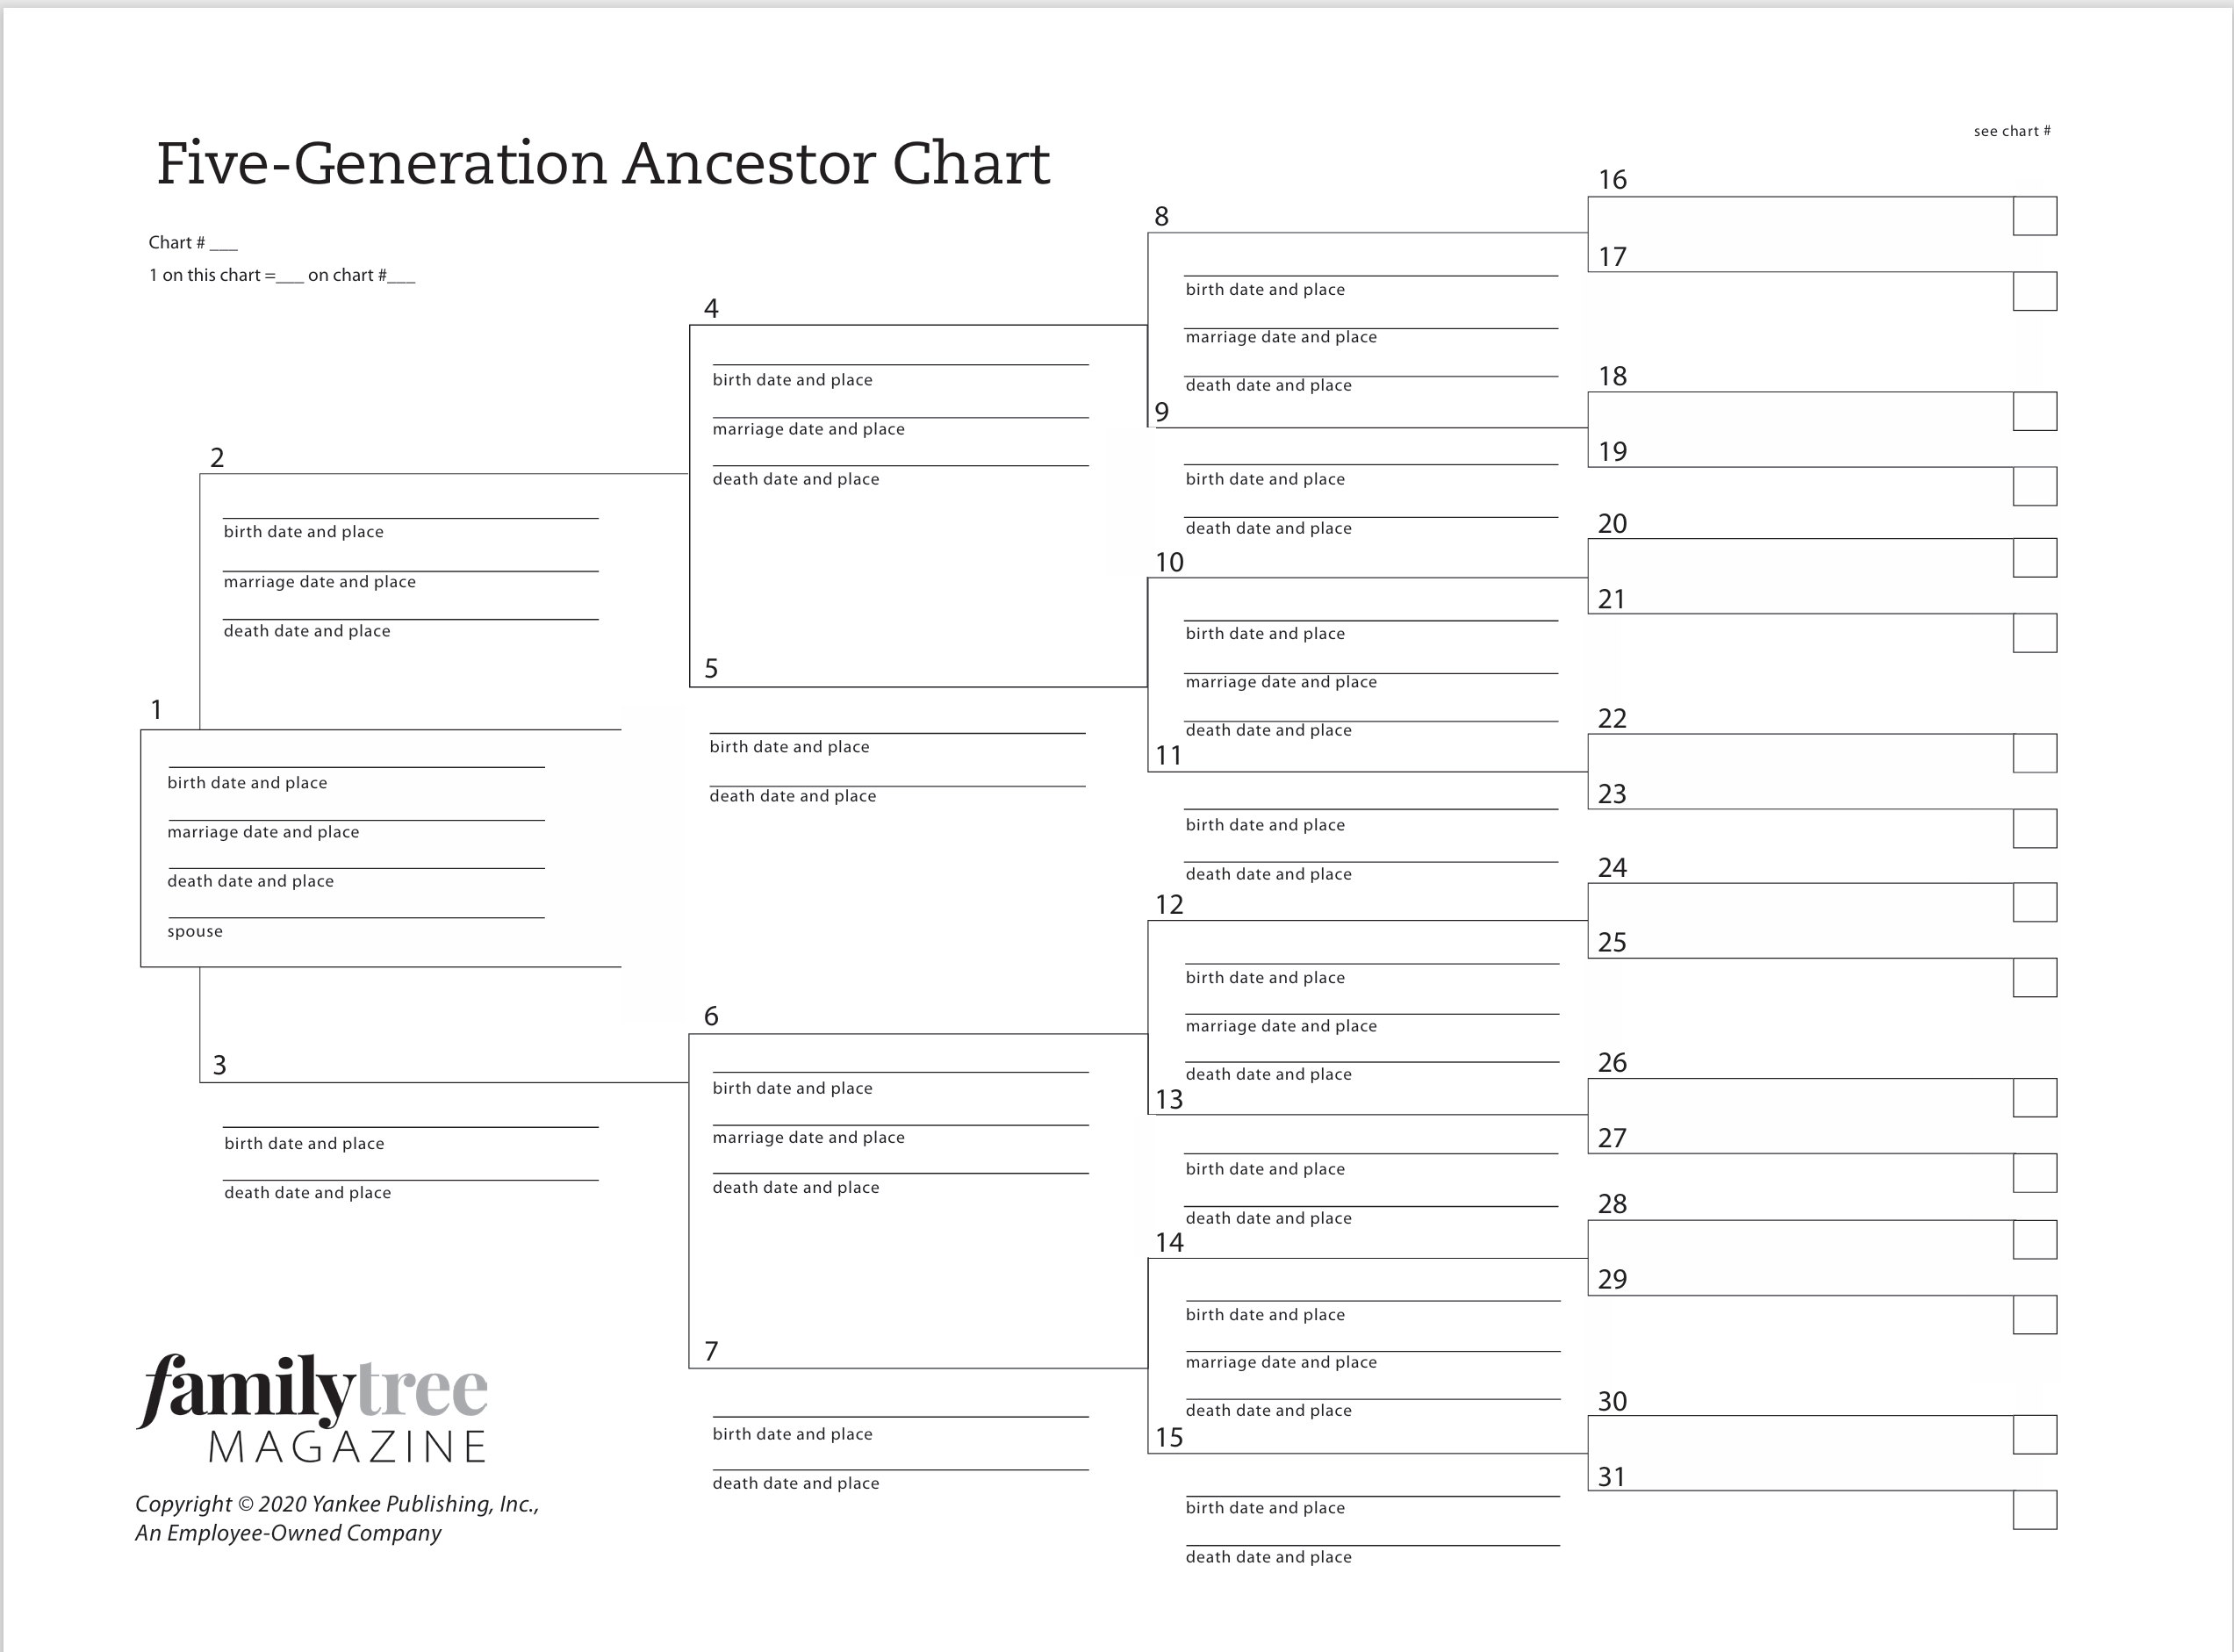

Slide 7
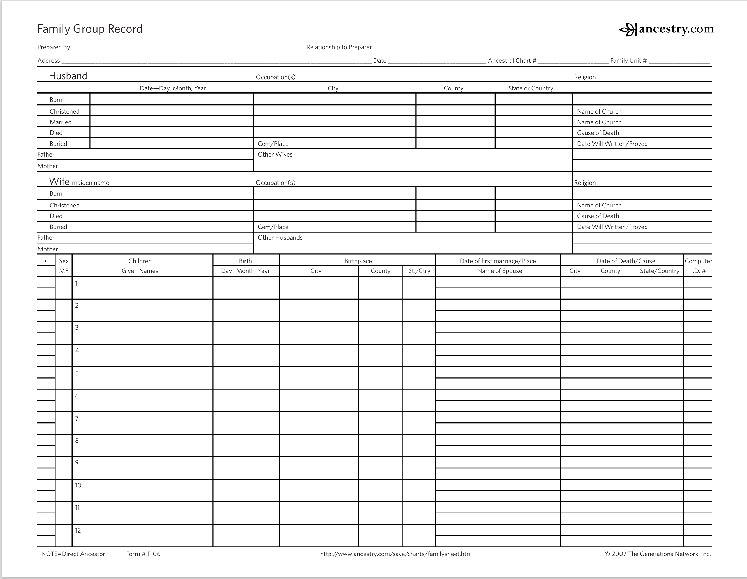

Slide 8
Standard Format for Recording Facts
Names
  Record full names at birth
  Use women’s maiden name
  Last name, first, middle
  Make note of any nicknames, preferred name or titles or surname variations
Dates
  Format day-month-year
  For example: 15 Jan 1975
  If not exact use about = “abt” after =“aft” before =“bef” between =“bet” calculated =“cal”
Places
  Always enter the place name as known on the day the event took place
  Record city or township, county, state and country
    Cheboygan, Cheboygan, Michigan, USA
    Benton Township, Cheboygan, Michigan, USA
Notes:
Standard format for recording genealogical facts
When recording genealogical facts, it is essential to follow a standard format to ensure clarity and consistency. Here are some key points to consider:
Some Does and Don’t When Recording Facts
Keep track of all surname spelling variations.
Do not abbreviate names, dates and places.
Enter the full name: first, middle, and last.
Organizes by last name, first, middle.
For women, supply the full maiden name, not a married name.
Write dates in this format: Day-Month-Year
Enter full place names: City, County, State (e.g., Mineola, Nassau, New York).

Slide 9
Interviewing Living Relatives
Contact Living Relatives for Information
Reach out to as many relatives as possible
Collect copies of important documents and photographs
Preserve Memories and Family Stories
Ask relatives to share stories and memories
Document family heirlooms with photos
Importance of Timely Documentation
Memories can fade and records may be lost
Capture information while relatives are available
Validage Family Lore
Identify Old Photographs
Notes:
Once you’ve learned all you can from the items that you have reach out to living relatives to find out what they can share.
What photos can they share with you or do you have photos that they may be able to help you identify an unknown subject
Hopefully, they will allow you to make scans or copies of photo and documents that they have.
Take pictures of heirlooms that they have like your great-grandmother's tea set.
Unfortunately, as many of us know all too well, people won’t always be around to share their stories, and memories can fade, or family records or pictures can easily be lost or given away
These living relatives may have information that you will not be able to find anywhere else.
Conduct interviews (Oral-History-Interview-Record.pdf ). You’ll need to validate family lore, but information passed down from generation to generation can give your research some direction.

Slide 10

Tips for Conducting Family History Interviews
Share Interview Questions in Advance
  Gives your relative time to recall details
  Helps them prepare thoughtful responses
Bring Essential Supplies
  Notebook and writing utensils for notes
  Printout of your interview questions for reference
Record the Interview if Possible
  Use a recording app or tape recorder
  Consider video recording for richer documentation
Include Family Photos and Mementos
Overcome Nervousness and Just Ask
Respect Boundaries and Feelings
Notes:
arrange an interview with your relative in advance so as not to catch them off guard.
If you can’t conduct the interview in person, you can request to interview someone over the phone or through email.
share your questions ahead of time, this will help them to not feel put on the spot and give them an opportunity to recall detail
bring note-taking supplies, a notebook and writing supplies or a sheet with your questions printed out
And if they will let you record the interview, what a treasure to have their responses in their own voice to preserve for generations to come. If you’ve ask ahead of time would they mind you recording have a recording app downloaded and tested before you get to the interview.
Maybe they will let you video record the interview, even more special.
Be sure to bring any old family photos or mementos that you want to learn more about. Your relative may be able to answer those questions, and an old photo may help bring back valuable memories.
Don’t be shy! It can be a bit scary to approach a grandparent or older relative and ask to interview them about their life. Don’t be discouraged, though, because most likely your relative will more than understand your desire to document the family’s history and be happy to oblige.
Most importantly, respect your relative’s feelings and boundaries. If they don’t feel comfortable answering a certain question, or are not okay with the interview being recorded, make sure they know that you honor those guidelines and appreciate their help documenting the story of your family.

Slide 11
Choosing and Tailoring Interview Questions
Use the Provided List of 100 Questions
  Select questions relevant to your interviewee and family context
  Customize the sequence to suit individual needs
Prioritize Key Questions
  Choose questions you most want answered
  Avoid overwhelming the interviewee with too many questions
Adapt and Add Questions as Needed
  Include additional questions that fit your situation
  Be flexible and responsive during the interview
Consider Emotional Impact
  Recognize that interviews can be personal and emotional
Plan for Follow-Up
Notes:
When preparing for a personal interview, select relevant questions from the provided list, prioritize what matters most, and adapt as needed. Be sensitive to emotional topics, avoid overwhelming your interviewee, and consider follow-up interviews for deeper insights.
Original Content:
Attached are 100 questions. Use this list as a guide to tailor your interview for the individual you are interviewing and relevant for your family. Pick and choose from the list and compile your own sequence of questions and add other questions that you think would be relevant. In most cases, all 100 questions will be far too many and will overwhelm your interviewee. Instead, prioritize the questions you really want to know and then ask more if the opportunity arises or ask for a follow-up interview. Remember, an interview of this kind is a very personal experience and can be emotional for the person being interviewed. Try to avoid questions that may be upsetting or irrelevant.

Slide 12
Genealogical Proof Standard (GPS)
Five Steps of the Genealogical Proof Standard
Step | Description
Exhaustive Research | Gather all relevant information
Source Citation | Document sources accurately
Evidence Correlation | Interpret and connect reliable evidence
Resolve Contradictions | Address conflicting evidence
Sound Conclusion | Write clear, reasoned findings
What is the Genealogical Proof Standard
  A Process that ensures credible and reliable genealogical research
  Applies to both professionals and hobbyists
Five Essential Steps for Accurate Research
  Conduct reasonably exhaustive research
  Provide complete and accurate source citations
  Skillfully correlate and interpret reliable evidence
  Resolve any contradictory evidence
  Formulate a sound conclusion
Benefits for Future Research and When Sharing Research with Others
Notes:
Before going further in your research it is important to be familiar with the Genealogical Proof Standard which provides a framework for credible research.
It will help you avoid unsupported assumptions and help you build an accurate family tree.
Researching family history can get complicated, with numerous records, websites, and books each offering a piece of the puzzle.
Using the Genealogical Proof Standard helps validate your research and supports your findings.
The Genealogical Proof Standard is a process designed to clarify what we know and what we need to learn, facilitate explanation of work to others, provide a framework for addressing complex research questions using indirect evidence, and support the formulation of sound conclusions.
Applying the Genealogical Proof Standard at the outset of research can streamline future reviews of prior work and help address any uncertainties about earlier genealogical findings. It also provides a framework for assessing new information that might impact existing research.
There are five steps to the Genealogical Proof Standard
reasonably exhaustive research
each fact has a complete and accurate source citation
evidence is reliable and has been skillfully correlated and interpreted
contradictory evidence has been resolved
your conclusions have been soundly reasoned and coherently written
Don’t panic or be discouraged this sounds more daunting than it really is and using this process will boost your confidence in the accuracy or your findings.
We’ll go into each step in more depth on the next few slides

Slide 13
Reasonably Exhaustive Research
Definition of Reasonably Exhaustive Research
  Thorough investigation
  Focuses on quality not quantity
Types of Records to Consult
  Each record may answer specific questions about ancestors
  No one record has all the information
Importance of Organization
  Using a checklist helps track of reviewed sources
Limitations of Online Research
Accessing Offline Resources
Genealogical Research as an Ongoing Process
Notes:
Reasonably exhaustive research means being thorough in consulting various records to collect facts about your ancestors
There is no set number of records that need to be researched, however, it is good if you can find more than one reliable source to support facts you record
We will go into more detail on the types of records to research later
using checklists to track records you have reviewed helps keep your research organized and guides future research for unanswered questions
Online tools are helpful but incomplete, so offline resources may be needed.
many records remain inaccessible or undigitized.
You may only be able to find an index online or not at all and need to go to a repository for get a copy of the original document
you may need to contact local archives or visit in person.
Research is ongoing, new records are becoming available all the time online or where there were once only an index, the full record becomes available or unindexed records that have to be search manually can now be searched automatically.
Genealogical research is often an ongoing process.

Slide 14
Source Citation for Each Statement of Fact
Essential Citation Information
Element | Purpose | Example
Author/Creator | Attribution | Jane Smith
Title | Identification | History of Art
Page/ID Number | Location | p. 45 / Vol. 2
Date Accessed | Online Reference | 01 May 2025
Publication Date | Relevance | 2019
Repository | Retrieval | City Library
Documenting Sources for Reliability
  Ensures research is credible and trustworthy
  Allows others to verify findings
Resolving Discrepancies
  Helps address conflicting or new information
  Facilitates correction of errors
Do This for all Types of Sources
Notes:
What to include in a source citation
The name of the author or creator
The title of the publication or record set
The page number, volume, catalog and/or identification number
The date you accessed the source, particularly important for online sources
The publication or creation date
The repository of the source
Again, don’t feel overwhelmed, the point is for you or someone else to be able to lay their hands or eyes on the sources that your facts come from.
We will get into the online platforms and software in a bit, but it you are using one of these they do a lot of the source citing and organization for you by linking them to people and facts.
However, sources found outside of the online platforms whether they are digital of hardcopy will require you annotating this information.
Accurate citations are crucial for evaluating evidence, retrieving originals, and enabling others to replicate your research.
Check Your Facts and Cite Your Sources
When conducting thorough genealogical research, document your sources accurately to ensure your work is reliable and credible.
Proper documentation enables others to verify your findings and helps resolve discrepancies when new or conflicting information emerges.
Citing your sources means recording where your data comes from, and it’s best to cite and organize sources—digital or hardcopy—as you find them.
Unless you intend to publish your family history, a formal citation with a specific format is not required; however, you should include all necessary details to identify and locate the original record.

Slide 15
Types of Sources: Original, Derivative, Primary, Secondary
Original Sources: Higher Accuracy
  Created close to the event, increasing reliability
  Preferred for genealogical research
Potential Errors in Original Records
  Unintentional mistakes may occur
  Occasional deliberate falsification, such as back-dating
Derivative Sources: Compiled Evidence
  Based on other sources
Advantages and Limitations of Derivative Sources
Primary Information
  Likely to be in original documents for a specific purpose
Secondary Information: Less Reliable
Notes:
Original sources are preferred for genealogical research due to their accuracy, though errors can occur.
they are generally created closer to the event
usually prepared by a directed witnesses or from information supplied by a direct witness
they can have errors, for example; dates may be altered either on a marriage recorded or birth date to account for a pregnancy at the time of marriage or it is a birth certificate produced based on information provided decades after the event or, names are spelled based on how they sounded or unintentional errors
Derivative sources can be compiled from multiple sources or a transcription or translation of an original document, but sometimes that’s all you can find and they can provide clues
they are not as accurate as original documents and are more likely to contain errors
if you are looking at a transcription there may be errors created because of poor handwriting or a bad scan of the original document
you could be looking at a poor translation or the original meaning was lost in the translation or the original handwriting was difficult to read
family histories are generally created from stories from or interviews of family members whose memories may have been faulty
family trees created by other people with undocumented facts
collections of or compilations of town records for example are prepared by one person transcribing or compiling a variety of from a variety of sources
Primary information is firsthand, so original sources generally provide primary information.
Most sources contain primary and secondary information. For instance, while a death certificate provides primary information regarding the death, it may present secondary information about the individual's birthor parents’ names, which may or may not be accurate.
Secondary information is less reliable. Another example would be information on a marriage record, the date of marriage would be considered primary, but the age of the bride and groom are secondary
Most published sources are considered secondary, like family histories, however, some printed materials, like city directories, are an exceptions.
Then there are censuses, which are generally considered primary sources of information because they are an official document, but we are at the mercy of the enumerator, their interpretation of information and handwriting and also sometimes information may have been provided by someone other than the head of household or their spouse
Whoever was home at the time
Or a neighbor
In particular censuses are not considered primary for age or birth
While primary sources are preferred for accuracy, secondary sources can still provide useful context and research leads.

Slide 16

Analyzing and Interpreting Evidence
Gathering Evidence About Ancestors
  Collect facts from various sources
  Ensure information is comprehensive
Carefully Review Sources
  Shape your understanding of relatives
  Identify patterns and connections
Developing Analysis Skills
  Practice and experience improve interpretation
  Refine skills over time
Evaluating Sources
  Assess reliability and accuracy
Drawing Accurate Conclusions
Notes:
gather your sources together to compare evidence presented
Get a comprehensive collection of sources for your ancestor
draw conclusion as to accuracy of evidence for specific facts
Our next slide will focus on the quality of sources and which are more trustworthy
Learning to analyze sources is a skill that comes with practice and experience. As you utilize different record types and gather facts from them, you will improve your evaluation skills the confident you will be in the reliability of the facts supported
Reliable sources help you draw accurate conclusions about your ancestor

Slide 17
Resolving Contradictions in Evidence
Consolidate Evidence Found on Diverse Sources
Don’t Overlook Contradictions in Research
  Carefully consider all mismatching information
Ask Questions
  When and where the record was created
  Identify missing or incomplete information
  Examine how the information was recorded
  Determine who created the record and purpose
  How reliable is the source
  Evaluate the Reliability of the Information
Conclusions
  Combine diverse information for well-supported conclusion
  Provide reasoned explanations for contradictions
Continuous Evaluation Process
  Corroboration and Inconsistency Identification
Notes:
While doing your research you will be consolidating evidence from diverse sources that you’ve gathered
combine and deconflict to form a well-supported conclusion.
It is crucial to resolve inconsistencies found in the evidence, don’t overlook these inconsistencies
Ask questions
When and where was the record created? Assess the historical and geographical context
What information is missing or incomplete from the record?
How was the information recorded?
Who created the record?
How reliable is the information in the record?
Make sure conclusions are well-supported
,explain how or why you reached your conclusion
differing year for birth date
The evaluation of evidence is a continual process, beginning with the first evidence of a fact and any subsequent sources to that fact.
As new sources are reviewed compare evidence to pre-existing data from prior research to establish corroboration or identify inconsistencies.

Slide 18
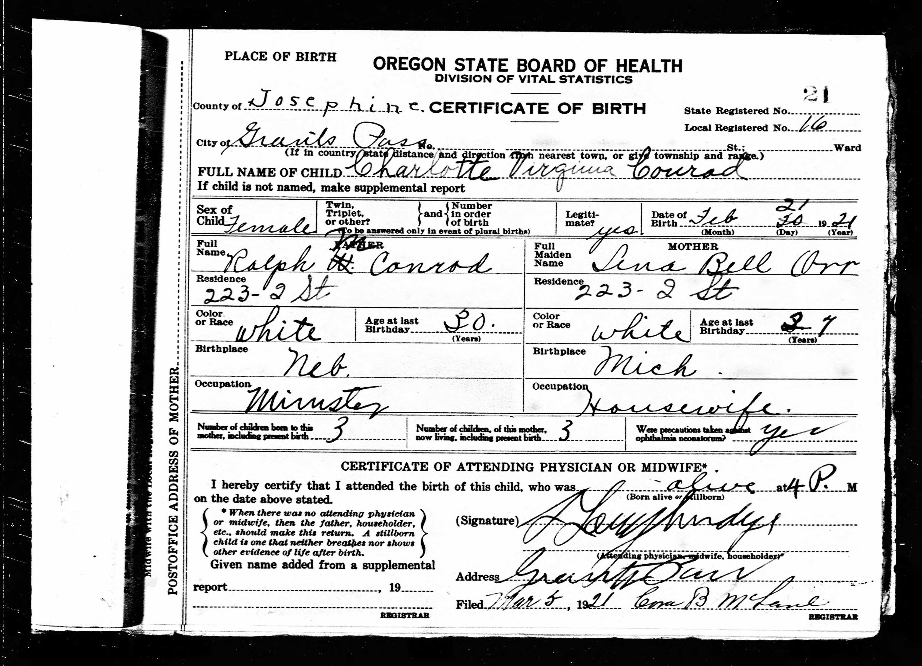
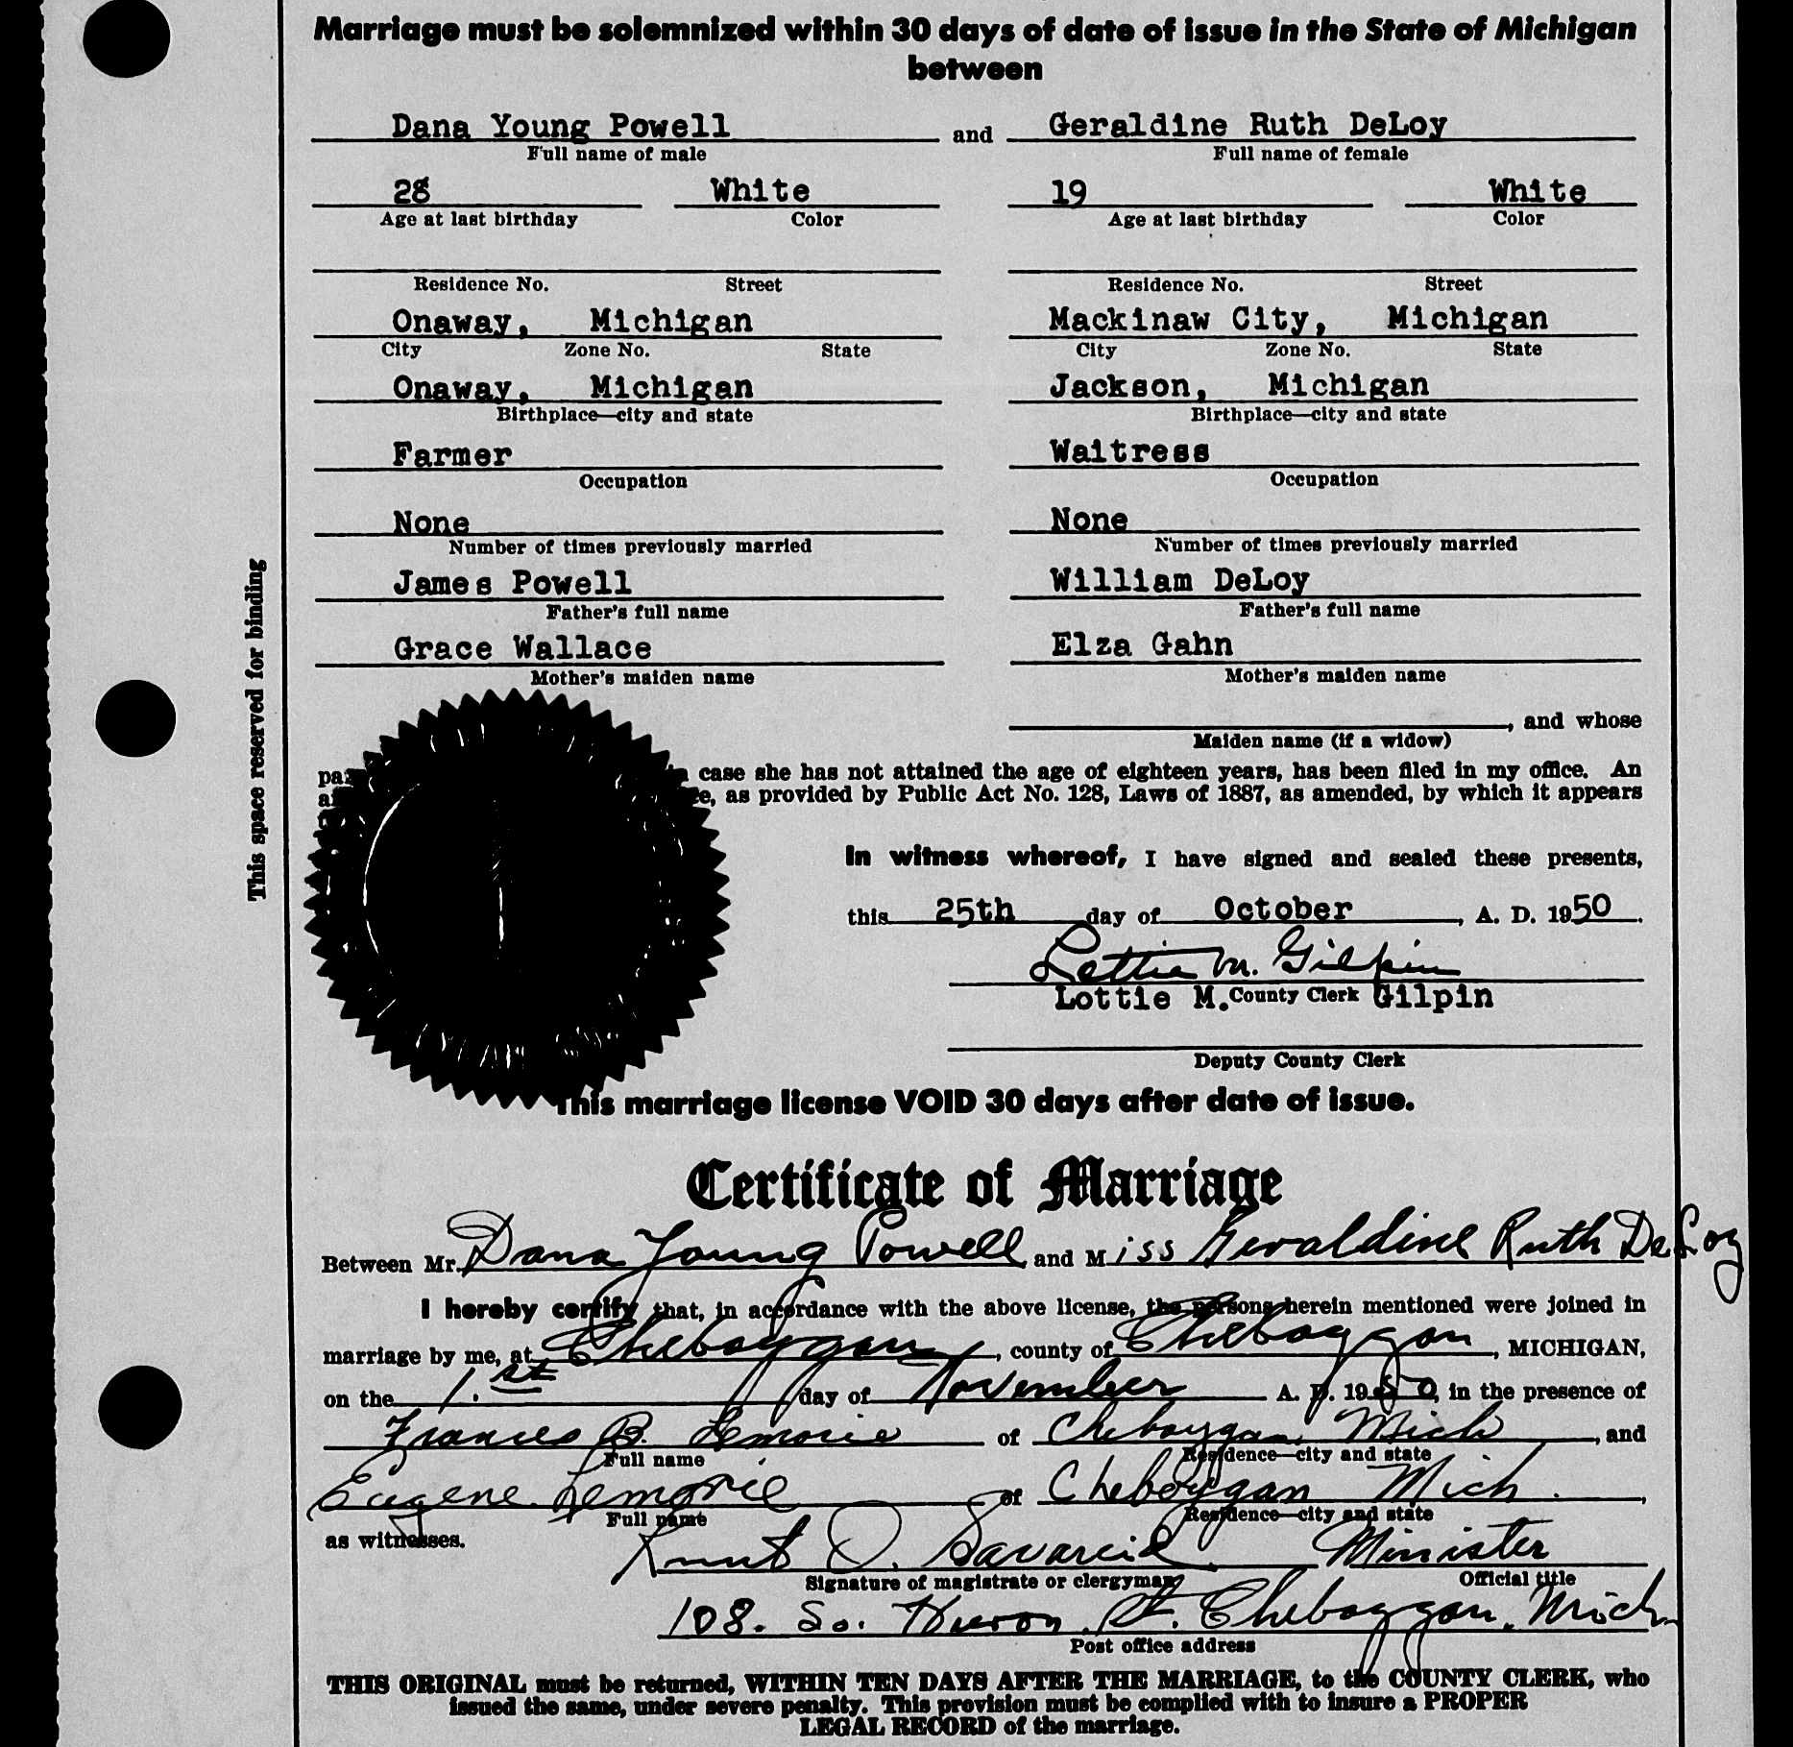
Vital Records: Birth, Marriage, Divorce, Death
Birth Records
  Include date, location, and parents' names
  May list father's occupation and mother's maiden name
  Maintained by local authorities
  Baptism records and birth announcements as alternatives
Marriage Records
  Document marriage date and couple's names
  Often include ages, parents' names, and witnesses
  Kept by local authorities and churches
  Marriage and engagement announcements in newspapers
Divorce Records
Death Records
Notes:
Genealogy records include birth, marriage, divorce, and death documents. Each type provides key details and may be sourced from local authorities, churches, or newspapers. These records help trace family history, though accuracy can vary, especially for older or informant-provided information.
Original Content:
Genealogy Record Types
Birth records are established at the time of an individual's birth and typically detail the date and location of birth, along with the names of the parents. These records may also include additional information regarding the parents, such as father’s occupation and the mother's maiden name. Birth registrations are usually maintained by local government authorities. Baptism records from churches and religious organizations are sometimes used as alternatives to civil vital records, especially for periods before civil registration was standardized. Birth announcements can sometimes be found in local newspapers.
Marriage Records document a couple's marriage date and names, often including ages, name of parents, and witnesses. These records are maintained by local government authorities. Marriage records from churches and religious organizations are sometimes used as alternatives to civil vital records, especially for periods before standardized civil registration. Marriage and engagement announcements also appear in newspapers.
Divorce records document the end of a marriage and are sporadically available. They will typically provide the date of marriage and divorce and identify minor children with ages at the time of divorce.
Death Records are created when an individual dies and typically list the date, location, cause of death, birth details, parental information, last residence, and informant's name. While local governments usually record these, church records may also serve as sources for earlier periods. Because the information is provided by someone other than the deceased, some information found may not be accurate. Local newspapers may offer additional details through death notices and obituaries.

Slide 19

Cemetery Records and Church Records
Cemetery Records
  Include images or transcriptions of tombstones and burial records
  List names, birth, death and burial dates of individuals
Family Connections in Cemeteries
  Relatives often buried near each other
  One record may lead to discovering more family members
Online Resources
  Find a Grave
  Billion Graves
Church Records as Alternative Sources
Challenges in Finding Church Records
Notes:
Cemetery Records may include images or transcriptions of tombstones or other burial records kept by the cemetery. Cemetery records typically list a person's name and birth and death dates. Family members were often buried near each other, so one discovery may lead you to others. Some people buried in a cemetery may not have a burial marker, particularly if they died previous to the mid to late 1800s. These are secondary sources, but provide hints for facts to be verified with primary sources.
Church Records, as mentioned above, may contain details such as births, marriages, deaths, burials, christenings, and membership lists. Finding these records in the United States is often difficult due to incomplete documentation, lost records, or scattered locations. Common denominations with recorded events include Catholics, Lutherans, Congregationalists, Reformed churches, and Presbyterians.
Cemetery records provide names and dates, often revealing family connections, though some burials lack markers.

Slide 20
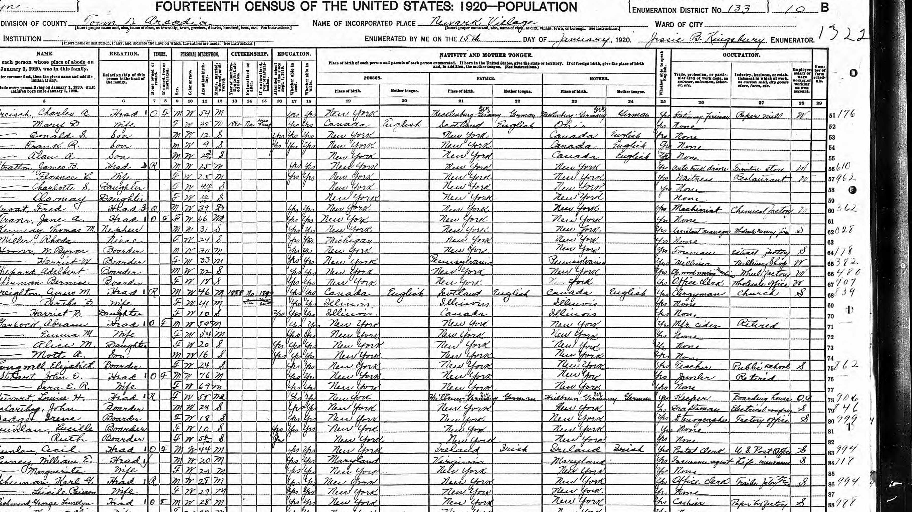
Census Records
Federal Census Records Timeline
  Every decade since 1790
Early Census Record Format
  1790 to 1840 only head of household recorded by name
  1850 to 1950 all residents of home recorded
  1890 census was destroyed by fire
  Each census records slightly different information
Modern Census Record
  Post-1950 censuses are not publicly available
State Census Records
  Various states have censuses available between the Federal census at varying times
Importance and Accuracy of Census Records
Notes:
Census records, collected every decade since 1790, list household members and details, with formats evolving over time. Both sources are crucial for tracing ancestry, despite occasional inaccuracies.
Original Content:
Census Records
Federal census records have been collected every decade in the United States since 1790.
Between 1790 and 1840, census records listed only the head of household by name, with tally marks used to indicate the sex and age ranges of other household members.
From 1850 through 1950, all individuals in a household were enumerated by full name, age, place of birth, and additional details. The 1890 census was largely destroyed by fire. Census records post-1950 are not yet available to the public. Census records become public 72 years after collection.
Several states conducted their own censuses in alternate years; these records vary by jurisdiction.
While census records may contain inaccuracies, they remain an important resource for tracing ancestors and identifying family relationships. Since the information collected on each census is different, it is advisable to locate individuals in every available census to develop a comprehensive understanding of their lives.

Slide 21

Newspapers, Obituaries, and Life Events
Role of Local Newspapers
  Recorded stories and events about people
  Major events included marriages and births
Obituaries and Death Notices
  Published a few days after death
  Included details like death date, age, birth info, and relatives
  Detailed obituaries uncommon before 1880s
Coverage Limitations
  Some towns lacked local newspapers
  People might be mentioned in nearby city newspapers
Notes:
Local newspapers often recorded major life events, especially marriages and births. Obituaries provided details about deaths, though detailed notices were rare before the 1880s. When newspapers were unavailable, church records offered alternative documentation, though these could be hard to find due to incomplete or scattered records.
Original Content:
Newspapers and Obituaries
Local newspapers recorded a variety of stories and events about people. Marriages and births being the major events recorded.
Obituaries or death notices were often recorded a few days after a person's death and may include information such as death date, age at death, birth information, names of parents, names of living relatives and those predeceased and a variety of other life information. Detailed obituaries were not common before the 1880s and deaths may not have been recorded in newspapers at all previous to the mid to late 1800s.
Sometimes there wasn't a local newspaper printed in a particular town but people in that town may have been mentioned in a newspaper in a town or larger city nearby.

Slide 22
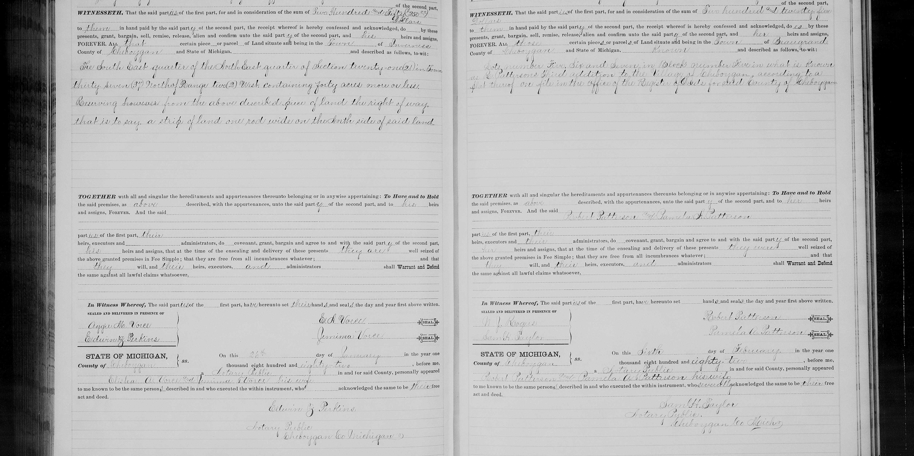
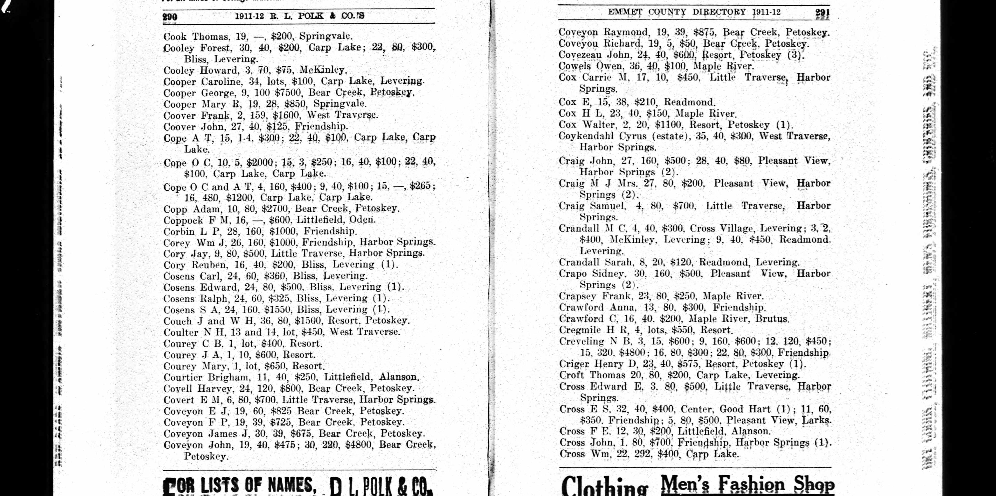
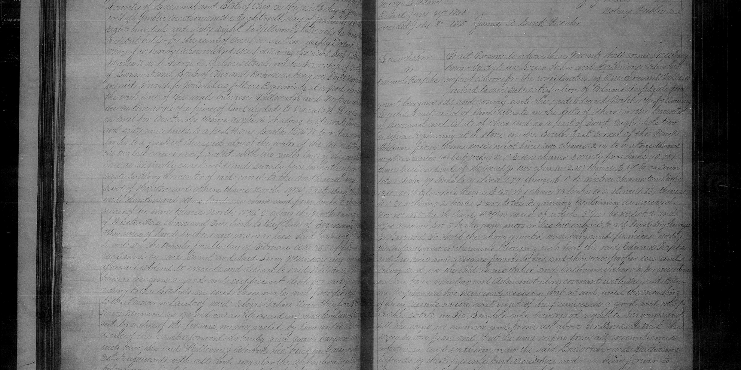
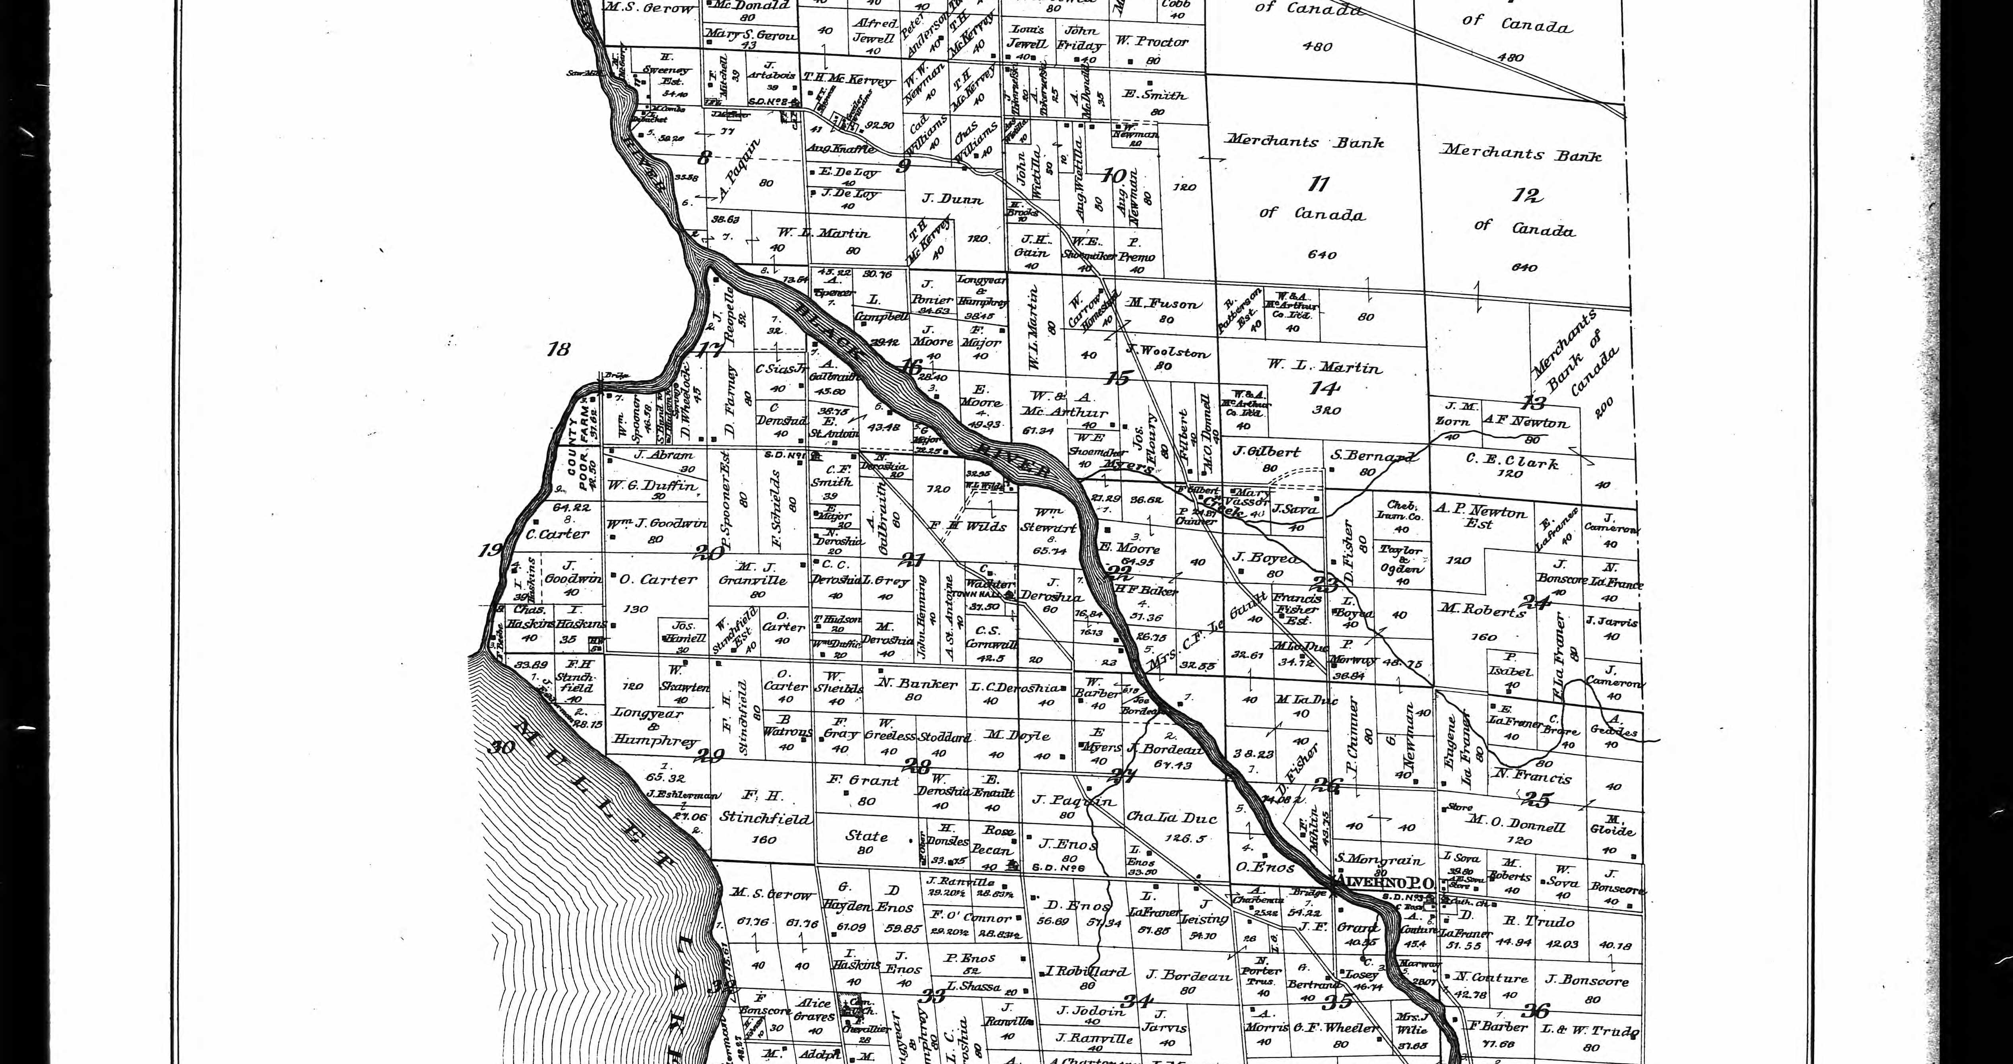
City Directories, Probate and Land Records
City Directories Track Residents
Probate Records for Asset Management
  Include wills, estate inventories, and guardianship papers
  List relatives and financial details
Importance of Probate Records
  The are some of the earliest records in new areas
  Useful when other sources are missing
Land Records Document Property Ownership
  Comprise deeds, land grants, and plat maps
  Show land descriptions, parties involved, and transaction details
Deeds Reveal Family and Social Connections
Land Maps Establish Location and Neighbors
Notes:
Probate records manage assets after death and list relatives. Land records show property ownership and family connections. City directories help locate ancestors, reveal occupations, and may indicate death years. Each record type provides unique details for genealogical research.
Original Content:
Probate Records are court documents used to manage a person's land or assets after death. They may include wills, estate inventories, letters of administration, and guardianship papers, often listing relatives and financial details. As some of the earliest records in new areas, they offer useful information when other sources are unavailable.
Land Records include land deeds, land grants, plat maps, or other records related to land.
Deeds record property transfers, noting land descriptions, parties' names, transaction amounts, and witnesses. They can also provide details about residence, family relationships and close neighbors. They can imply dates of marriage or death.
Land maps and plat maps can help to establish where the land was that a person owned and who their neighbors were.
Land records were usually among the first records kept in a newly settled area and can provide valuable information.
City Directories list names and addresses of residents in a town or city for a specific year, usually reflecting information from the year before. These directories help determine an ancestor’s location, occupation, home address, spouse, and neighbors, and could suggest the year of death for men if their spouse is identified as widowed.

Slide 23
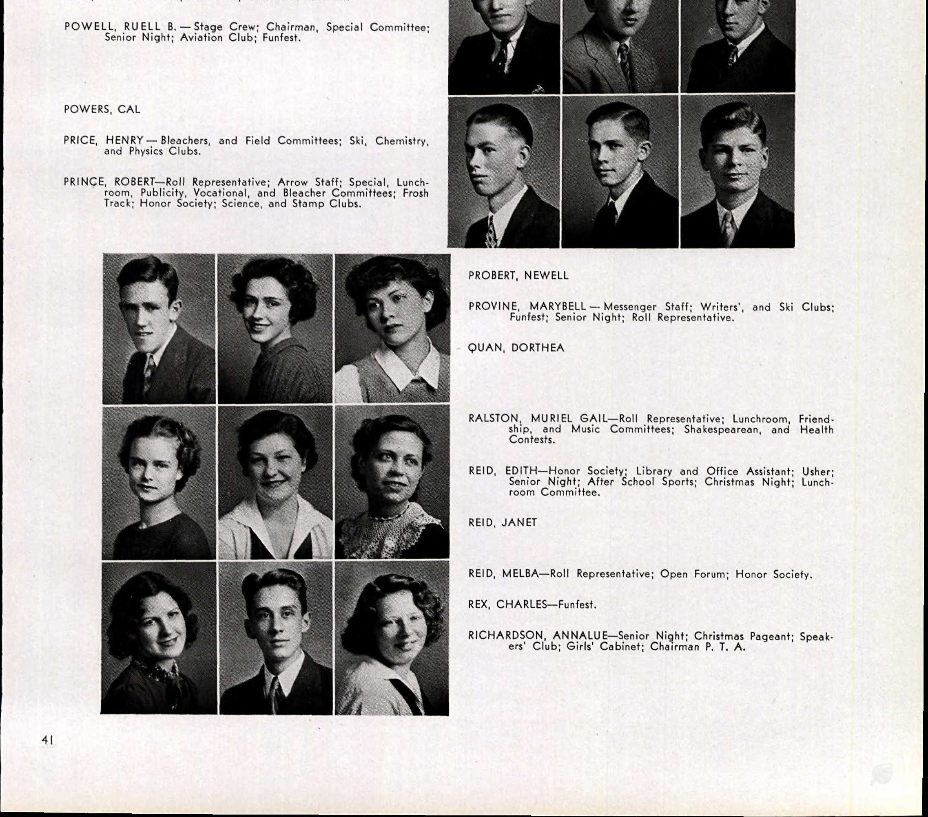
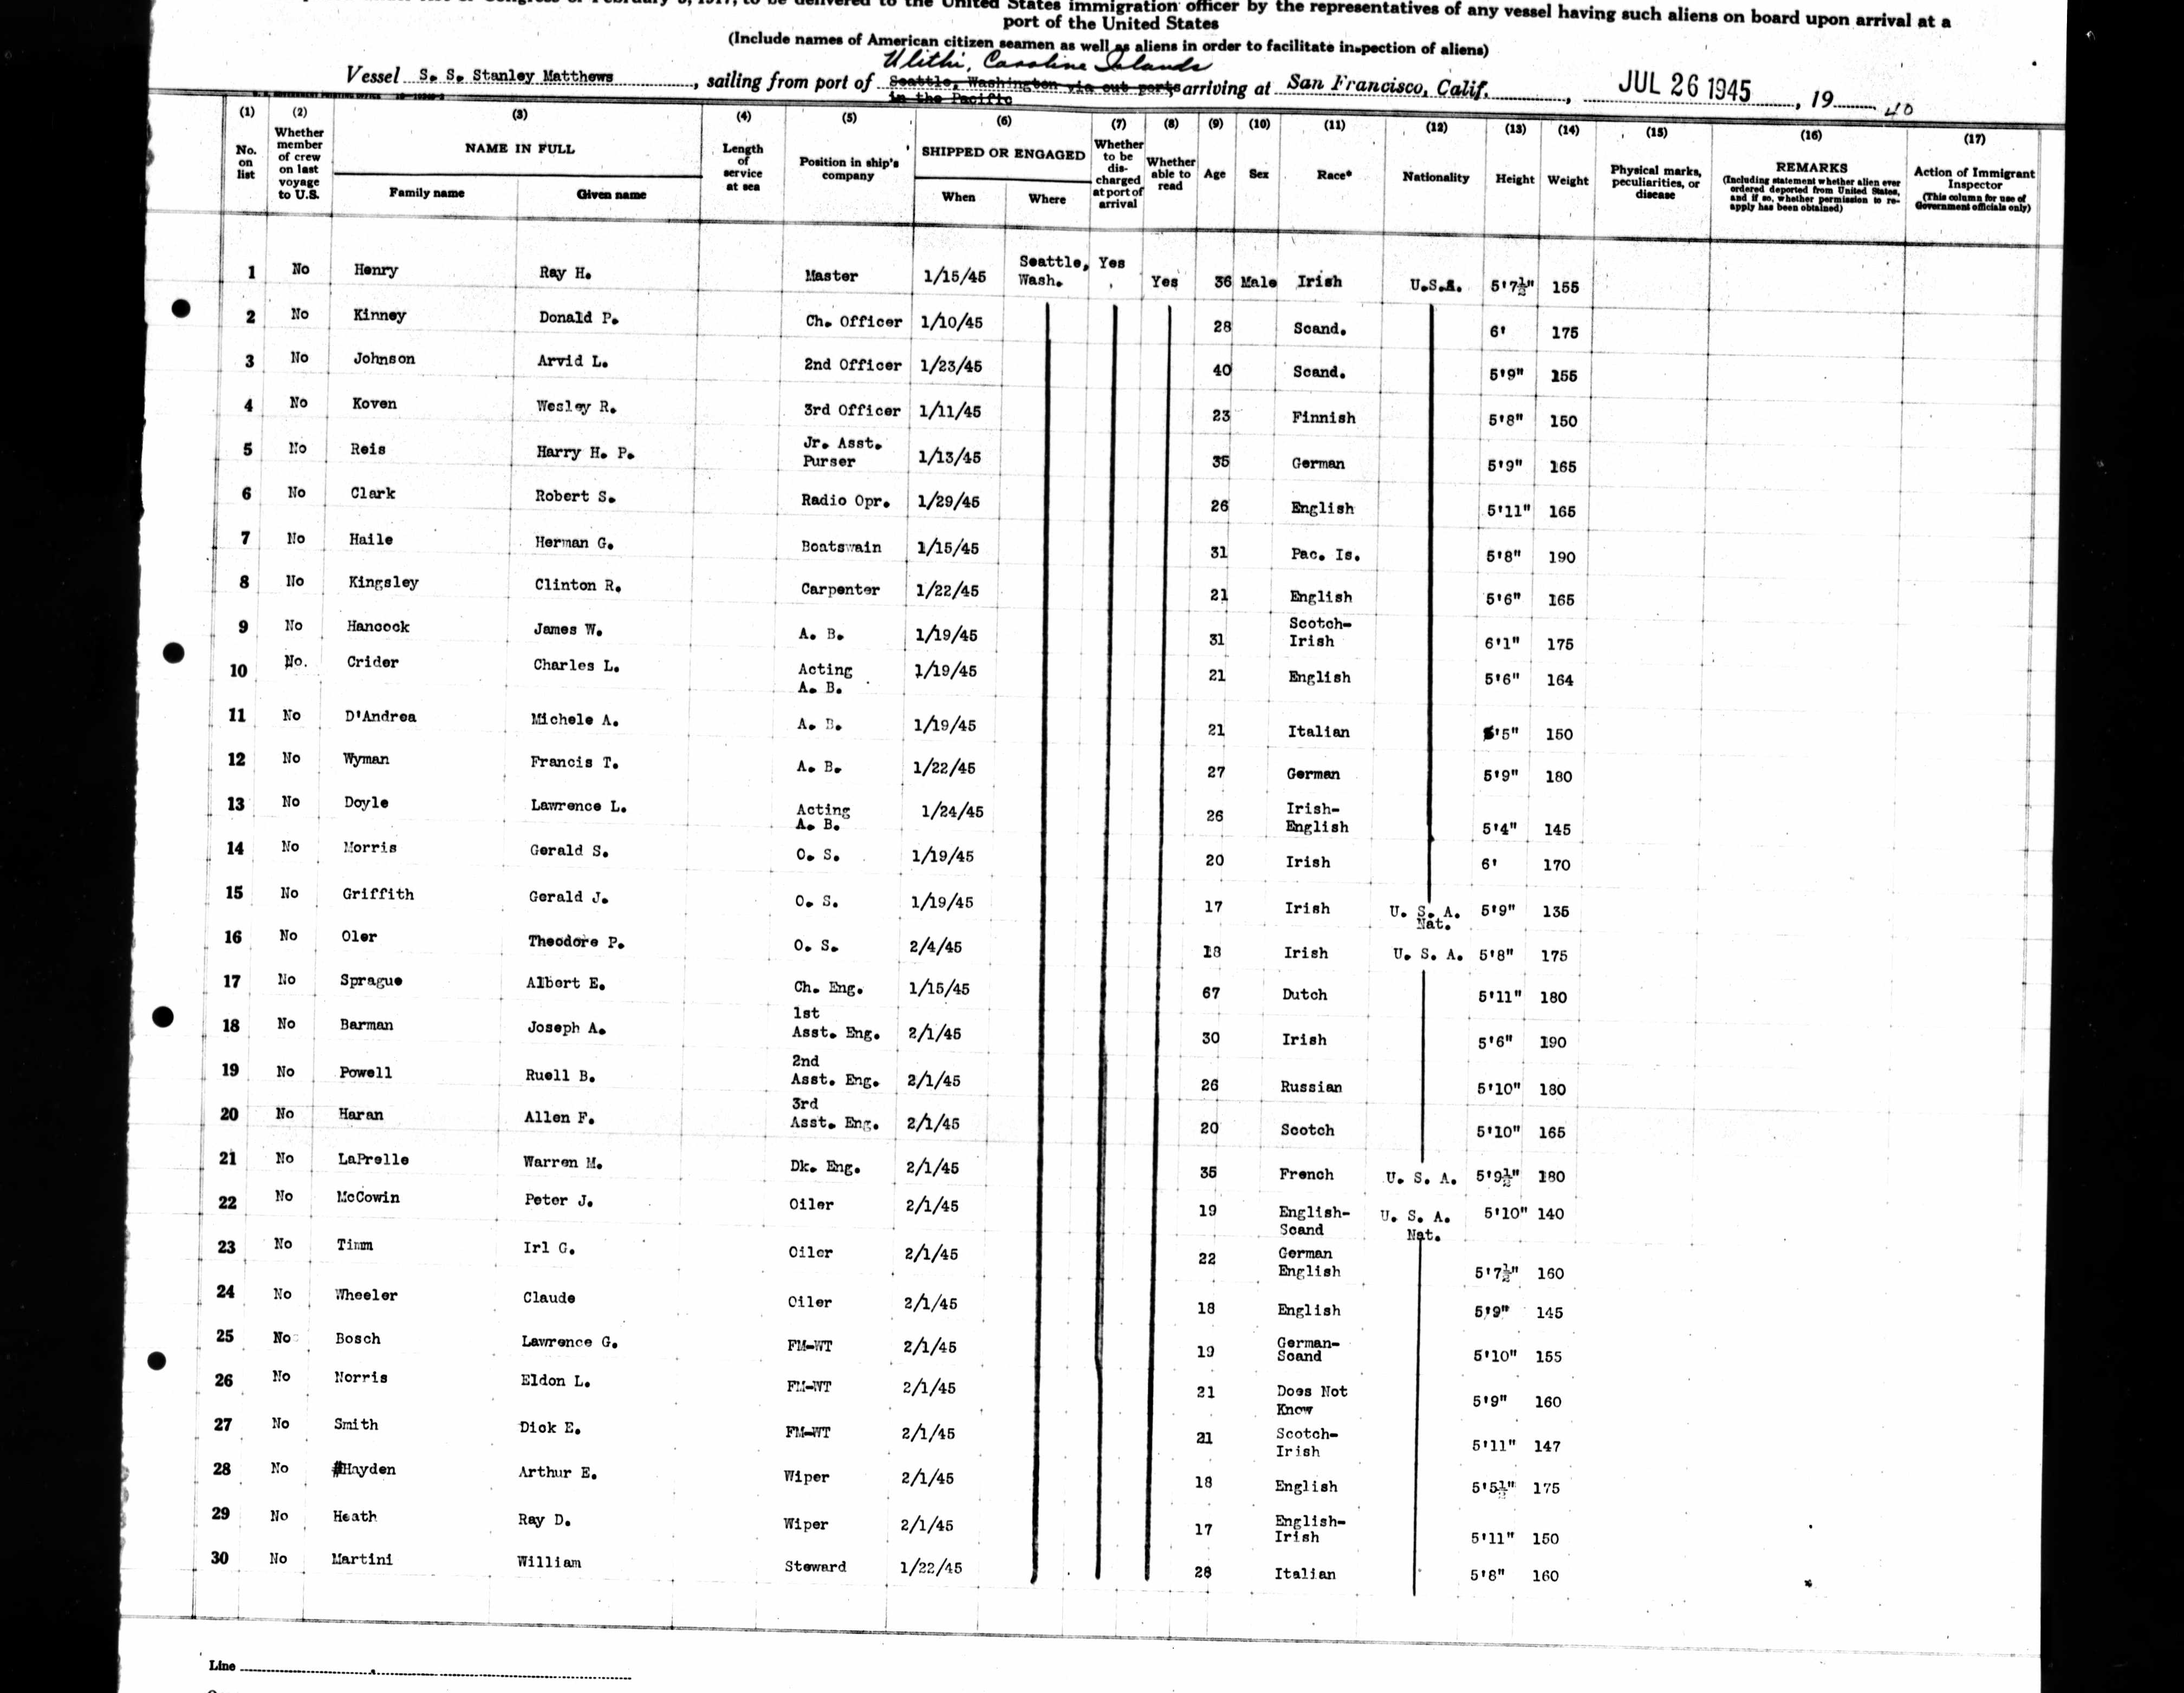
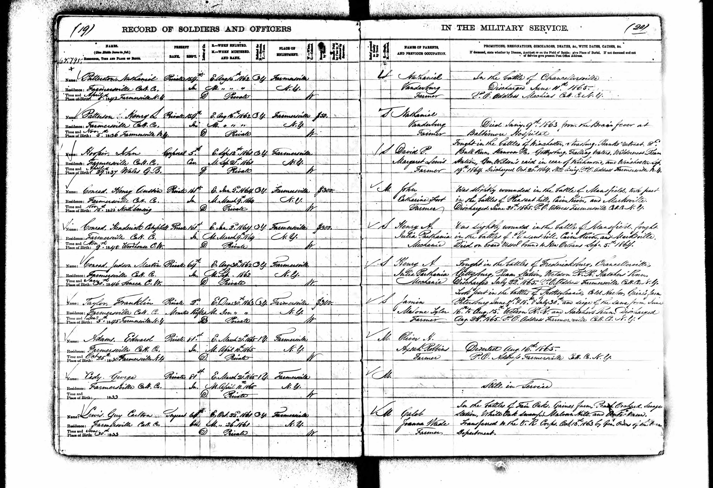
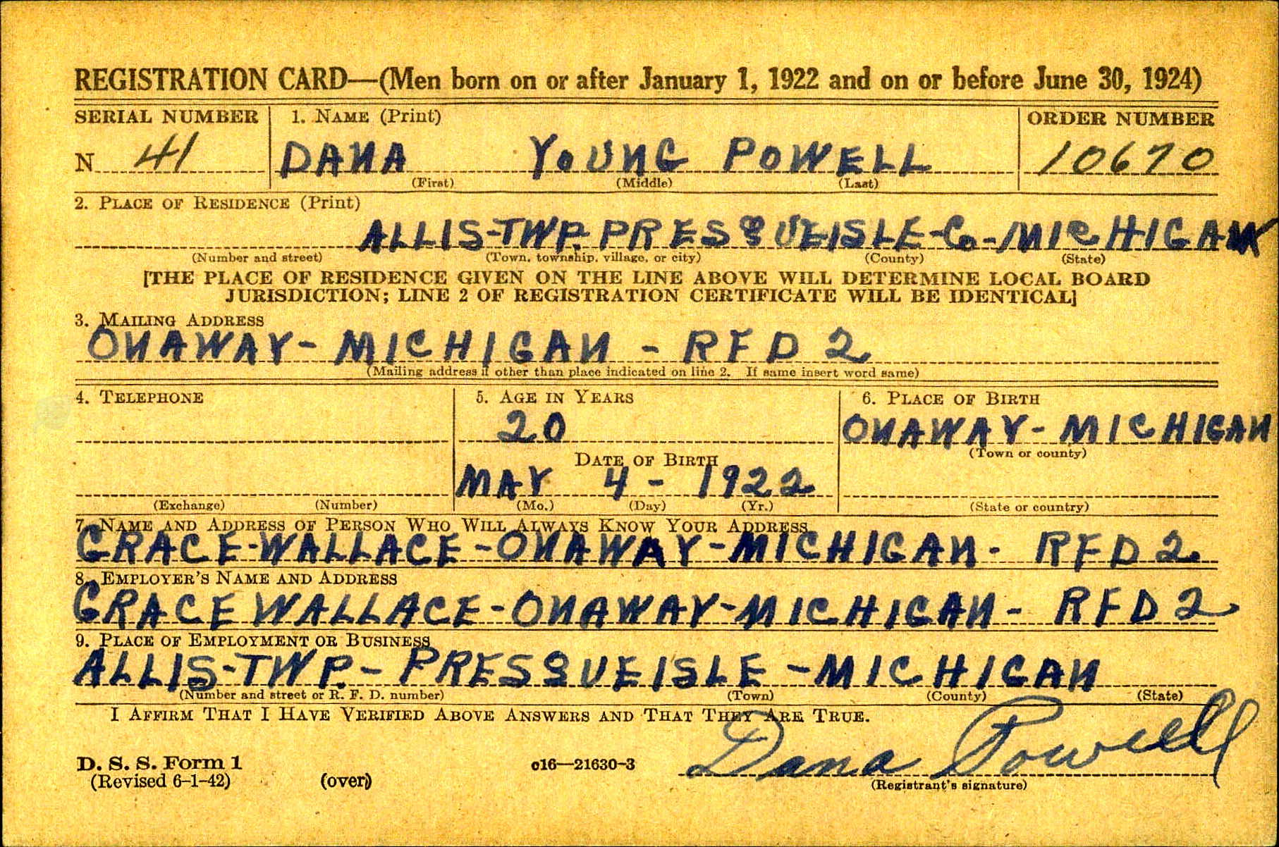
Military, Immigration, and School Records
Military Records and Their Significance
  Draft cards, enlistment records, service records, pension applications and burial
  May provide birth, residence, family, and service details
Immigration Records Overview
  Include ship passenger lists and naturalization documents
  Document movement between countries
Passenger Lists Information
  List names, ages, and sometimes place of origin
  Families often listed together
Naturalization Documents Details
  Contain name, age, witnesses, and origin
School Records and Yearbooks
Notes:
Military records reveal personal and service details from major wars. Immigration records, including passenger lists and naturalization documents, track movement and origins. School records, such as yearbooks and censuses, provide student information and school activities.
Original Content:
Military Records pertain to the military in some way. There are a variety of military records that were created because of the involvement of the United States in the Revolutionary War, the War of 1812, the Civil War, World War I, World War II, the Korean War, and the Vietnam War, etc. Military records in some cases can give birth information, residences, names of family members, details of military service, etc.
Immigration Records pertain to people moving from one country to another and can include ship passenger lists, naturalization documents, immigration/emigration information, etc.
Passenger lists often give names and ages of individuals and sometimes their place of origin. If people traveled with family members they were usually listed together on the passenger lists.
Naturalization documents can list a person's name, age, witnesses, and place of origin. In some cases, women were not required to naturalize separately from their husbands. Before 1906 in the United States, naturalization documents sometimes only listed a home country rather than a specific town or city where a person came from. Since 1906, more detailed information has been included in naturalization documents.
School Records are created by schools, colleges, and universities. They may include lists of students, yearbooks, school censuses, school histories, or other records. Yearbooks may contain photographs of individuals attending the school and information about the school activities they were involved in.

Slide 24
Tax, Court, and Miscellaneous Records
Tax Records
Include tax lists, enumeration lists, and other taxation info
Help establish residence and distinguish individuals with the same name
Indicate financial status and provide indirect evidence of death or family members
Often the earliest records in new settlements
Court Records
Created by the court system, with variations by state
Reveal personal details and relationships
Can help identify family, neighbors, or friends
Miscellaneous Records
Encompass Bible records, periodical indexes, town records, and more
Include lists of settlers, store ledgers, account books, and occupation lists
Notes:
Genealogical research uses tax records to establish residence and family status, court records to reveal personal details and relationships, and miscellaneous records like Bible entries and town lists to fill in gaps when other sources are missing.
Original Content:
Tax Records can include tax lists, enumeration lists, and other taxation information recorded by the local or national government. They may help to establish a person's residence, help to distinguish people of the same name in the same place, indicate the financial status of a family, or give indirect evidence of death and family members.
Tax records were usually among the first records kept in a newly settled area and can provide valuable information when other records are not available.
Court Records are produced by the court system, but each state governs them differently, affecting what records exist and where they’re stored. These records can reveal personal details and help identify family, neighbors, or friends.
Miscellaneous Records include records that can be helpful for genealogy research that don't fit in the above categories such as Bible records, periodical indexes, town records, lists of settlers, store ledgers, account books, lists of people in a certain occupation and place, passport applications, occupational records, government records, historical documents, and various other historical and genealogical records.

Slide 25
Family Histories, Social History, and Context
Verify Genealogical Sources
  Published family histories and genealogies are derivative and require validation with primary records
  Member-submitted online family trees may lack citations and reliability
Assess Oral Histories and Family Lore
  Document stories but research their accuracy before accepting them as fact
Study Social and Local History
  County or town histories and local histories provide context about ancestors’ lives
Go Beyond Dates
  Understanding community, challenges, and historical forces enriches family stories
Use Maps and Directories
  City directories and Sanborn maps reveal neighborhood layouts
Consider Historical Jurisdiction Boundaries
Notes:
When researching family history, always verify published genealogies and online trees with primary sources. Document oral stories, but check their accuracy. Study local histories and use maps to understand your ancestors’ communities, and remember that changing borders can affect where records are found.
Original Content:
Family Histories and Genealogies are published works containing genealogical data, such as biographies, family trees and books about pioneers families of a particular area, but as derivative sources, their details should be verified against primary records. Member-submitted family trees in online databases those you inherit may lack citations and may be unreliable, so it's essential to assess the authenticity of any genealogical information through your own research before relying on it. The same is true of oral histories and family lore. It is important to document these, but also research to assess the validity of these stories.
Study social history: County or town histories and local records offer valuable insights into your ancestors.
Your ancestor’s dates only tell part of their story. Learn about their community, challenges, and the forces that shaped their choices. Historical context can provide valuable insights into their lives and help you connect with past generations.
City directories and Sanborn Fire Insurance Maps reveal your ancestor’s neighborhood layout, while local histories and scholarly works offer context. Newspapers provide details about daily community life.
Maps can help you learn about your ancestor’s location and provide context for finding records. Understanding historical borders is important, since changes can affect where records are kept or under which placename. For example, shifting county boundaries might mean an ancestor lived in different counties while staying in one place. Reviewing historical maps helps identify the correct county for record searches at any given time.

Slide 26

Seeking Original Records and Looking Beyond the Page
Importance of Original Records
  Indexes may be incomplete or contain errors
  Original documents offer more comprehensive information
Accessing Original Documents
  Review images of originals online whenever possible
  Request copies from repositories if not available online
Exploring Beyond Referenced Pages
  Surrounding pages in census records may reveal relatives or neighbors
  Multiple pages in online records can contain additional data
Utilizing Entire Record Sets
  Books or directories may have valuable information in introductions or indexes
Notes:
View original records, which can be a good digitized copy of the record. Indexes, whether physical or digital, are often incomplete and may have errors and usually only contain a subset of the information available in the original document.
Always review images of original documents online. If originals aren’t available online you may be able to request a copy of the original from the repository where it is held, usually for a nominal fee.
Look beyond the referenced page
Checking surrounding pages in census records might uncover relatives or neighbors.
Also, some online records have multiple pages so always get in the habit of looking at the pages after the image that opens.
If the record set is a book or directory, you may also find valuable information elsewhere in the book, such as general information in the beginning or indexes at the end of the record set.

Slide 27
Not All Records Are Created Equal
Variation in Genealogical Record Quality
  Records differ in trustworthiness and accuracy
  Original records are generally most reliable
Impact of Record Creation Timing and Source
  Records made closer to the event are more dependable
  Relationship of record creator to event affects reliability
Potential for Errors in Records
  Mistakes can occur during creation, copying, or transcription
  Transliteration may introduce inaccuracies
U.S. Civil Registration Practices
  States began recording vital events at different times
Access to Vital Records Today
Notes:
Genealogical records differ in reliability, with original records being the most trustworthy. The timing and source of record creation matter, and errors can occur during copying or transcription. U.S. states started civil registration at different times, and access to these records now depends on state privacy laws.
Original Content:
Not all Records are Created Equal
This was referred to in the analysis and evaluation step of the Genealogical Proof Standard.
Genealogical records can vary significantly in quality and reliability. Original records are generally considered the most trustworthy and accurate. When and how a record was created (especially in relation to the event it’s documenting) can drastically affect the reliability of the information you find in it. In general, records created by people closer to an event (both in time and in relationship) are more reliable than those that weren’t. Considering all this, any record can have an errors either due to mistakes made at the time of creation, manual copying, transliteration or transcription.
U.S. states began civil registration of birth, marriage, and death at different times, without standardized information being collected. By the early 1900s most states were recording vital events. Today privacy laws for these records differ by state so what you are able to access varies from state to state.

Slide 28

Developing a Filing System and Organizing Information
Develop a Consistent Filing System
  Helps manage growing files and records
  Makes locating information easier
Organize by Surname and Individual
  Create folders for each surname
  Subfolders for each individual
Include Various Types of Materials
  Old photos of individuals and families
  Documents, letters, and memorabilia
Add Personal and Family Stories
Store Records Digitally and Physically
Notes:
To manage your family history records, use a consistent filing system. Organize files by surname and individual, include photos and documents, add family stories, and store records both digitally and physically for easy access and order.
Original Content:
Record and Document Your Information
Develop a consistent filing system. As you accumulate files, records and other data, it can be easy to feel like you’re drowning in stuff. By adopting a standard filing system, you can bring order to all that family history chaos and find your files quicker and more easily.
File the information in an organized way so that you can locate each individual in your ever-expanding collection. The best way might be to create a folder for each surname and then each individual (either on your computer or in your file cabinet) include old photos of them, their families, homes, and cemetery markers, plus their important documents, letters, and memorabilia. Add their stories—both those you heard as a child and those family members tell you. As mentioned earlier even if you are doing your research online you will still want to download copies of records to either print, digitally store or both.

Slide 29
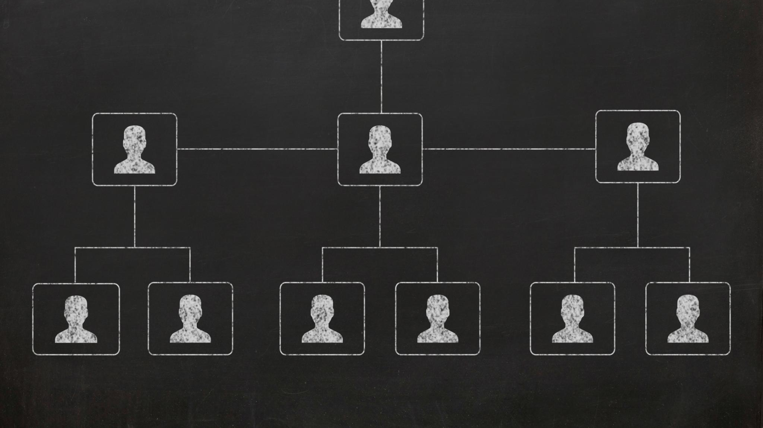
Exploring Leading Online Genealogical Platforms
Cater to Both Novices and Experienced Genealogist
Subscription Model Offering a Small Subset of Records for Free
Access to Historical Records
Family Tree Features: Tools for creating and managing family trees, adding photos, documents, and personal anecdotes to create a comprehensive family history.
Search Options: Extensive search options and filters to help users find specific records and ancestors.
Record Hints: Use algorithms to suggests records or member trees that may match your ancestors.
Community and Collaboration: Features that allow users to connect and share information, fostering a sense of community among researchers.
Some have DNA Tools: Advanced DNA testing services that can help identify genetic connections and provide insights into your ancestors.
Notes:
Online genealogical platforms offer a range of features that cater to both novice and experienced genealogists.
The majority of them have a subscription model to gain access to all of their record collections with a small number of records being available for free.
Historical Records: Access to a vast array of historical records, including birth certificates, marriage licenses, census records, and more form various countries and time periods.
Family Tree Features: Tools for creating and managing family trees, adding photos, documents, and personal anecdotes to create a comprehensive family history.
Search Options: Extensive search options and filters to help users find specific records and ancestors.
Record Hints: Use algorithms to suggests records or member trees that may match your ancestors.
Community and Collaboration: Features that allow users to connect and share information, fostering a sense of community among researchers.
Some have DNA Tools: Advanced DNA testing services that can help identify genetic connections and provide insights into your ancestors.

Slide 30
Ancestry, MyHeritage, FindMyPast, and FamilySearch
Genealogy Website Features Comparison
Website | Records (Billions) | Countries Covered | Access Type | Unique Features
Ancestry | 65+ | 80+ | Subscription | 140M user trees
My Heritage | 35+ | Non-US sets | Subscription | Unique non-US records
Find My Past | Billions | British Isles focus | Subscription | British records, expanding US
FamilySearch | 20.5+ | 170+ | Free | Church-supported, global reach
Notes:
Ancestry is the largest subscription genealogy company in the world. Ancestry boasts more than 65 billion records from 80-plus countries, plus 140 million user-submitted family trees. Free users can build a family tree and search the record collection of which a small subset will be viewable. To fully utilize the sites abilities a subscription is required.
My Heritage is a newer subscription genealogy company with over 35 billion historical records. This site has some non-US records sets not available on Ancestry.
Find My Past is the go-to source for the British Isles, also claiming billions of records. This site continues to expand its North American footprint, however most of these records are also available on Ancestry and My Heritage.
FamilySearch is made available by the Church of Jesus Christ of Latter-day Saints and free to everyone. It offers online access to records from more than 170 countries and principalities—more than 20.5 billion records in all. This platform has a one-tree model, which means you start with yourself and as you add relatives you eventually connect to the larger tree by contributions made by people who share ancestors with you.
On the subscription platforms you can make your tree public or private. The most beneficial choice is to make it public. Living people are never visible to anyone, but you

Slide 31
Choosing a Platform and Preserving Your Findings
Considers Subscription Cost and Size of Record Collections
Evaluate Platform Features
  Importance of tools
  Options for uploading photos and adding stories
  Collaboration and sharing with others
Switch Between Platforms for Unique Features
FamilySearch is a Cost-Effective Option
  Preferred by those avoiding subscription fees
  Some users don’t like the one-tree format because others can alter ancestors who are deceased
  Use for research and maintain tree in offline program
Whichever You Choose, Preserve Records
  Download records for safekeeping if you later cancel subscription or online record becomes unavailable
Synchronization With Offline Programs
Notes:
When selecting a genealogy platform, assess features for organizing and sharing research, collaboration options, and costs. Always back up important documents digitally and consider creating physical archives like scrapbooks or binders to ensure your family history is preserved for future generations.
People choose genealogy platforms based on features, cost, and tree format preferences. Some use multiple tools, while others prefer free or offline options. It's best to research each platform through their websites and online videos before making a decision.
Original Content:
When choosing a platform, consider not only the record collections and subscription cost, but also the features that will help you organize, annotate, and share your research with relatives. Some platforms allow you to upload photographs, add stories, and even collaborate with other family members in real time. Whichever you select, make sure you download copies of important documents and back up your work in multiple locations such as an external hard drive or cloud storage. Preserving your findings digitally ensures their safety for future generations.
You can also consider creating physical archives—scrapbooks, printed trees, or family history binders—for those who cherish tangible keepsakes.
Some people use multiple platforms to utilize the best features of each; some only use FamilySearch to avoid the subscription costs of other platforms. Some people don’t like the one tree format of FamilySearch and use an offline program to build and maintain their family tree and only use FamilySearch to do research and find records.
Before deciding it is recommended that you do a more thorough review of each platform by visiting their websites, researching through Google or viewing any of the many informational videos available on YouTube.

Slide 32
Overview of Offline Genealogical Software
Comparison of Offline Genealogical Software Features
Software | Free Version | Sync Options | Subscription Impact | Interfaces With
Family Tree Maker | No | Ancestry, | Records/hints restricted after cancellation | Ancestry, FamilySearch
Legacy Family Tree | Yes |  | Access remains for free version | FindMyPast, FamilySearch, MyHeritage
Family Historian | 30-day trial |  | Trial ends after 30 days | Find My Past, My Heritage, Family Search
My Heritage Family Tree Builder | Yes w/MyHeritage | My Heritage | Adding people/photos and documents locked after cancellation | My Heritage, Family Search
Roots Magic | Yes (Essentials) | Ancestry | Free version available indefinitely | Ancestry, Family Search
Notes:
hints with an active subscription. Keep in mind that if records are linked to your tree through such a site, cancelling your subscription will mean you can no longer view the source, though the reference to the source itself and the associated facts will remain in your tree.
Family Tree Maker is one of the pricier offline programs, however, it can synchronize with Ancestry and receive hints from Ancestry and FamilySearch. If you cancel your Ancestry subscription you can still view, edit, and manage your tree’s information, including adding people and photos. However, you will not be able to access records linked to your tree or receive hints that require a paid subscription.
Legacy Family Tree has a robust free version, and its interface is a lot like Microsoft Office, so it is easier for users familiar with Windows. It can also interface with FindMyPast, FamilySearch, GenealogyBank and MyHeritage to find hints.
Family Historian is a UK based software that offers a 30-day free trial. It is highly rated every year. It is only Windows based. It does interface with Find My Past, My Heritage and Family Search.
My Heritage Family Tree Builder is free and synchronizes with My Heritage. If you cancel your My Heritage subscription you won’t be able to add people or photos to your tree and access to many documents will be locked. It also interfaces with Family Search.
Roots Magic offers a free “Essentials” version that users can access indefinitely, or they may opt for the full version, typically priced at $39, with discounts occasionally available as high as 50% off. This program enables downloading of Ancestry family trees and synchronization between the software and Ancestry. Additionally, it provides integration with Family Search.

Slide 33
Evaluating Offline Programs for Your Needs
Assess Program Features to Ensure Alignment With Your Needs
Reporting Functionality
  Check for robust and customizable reporting tools
Charting Options
  Review available chart types and other visualization capabilities
Document and Photo Management
  Evaluate ease of storing and organizing files and images
Compatibility with Subscription Platforms
Long-Term Usability Post-Subscription
Consider Future DNA Analysis Requirements
Cost and Maintenance/Upgrade Fees

Slide 34
Continuing Research: Online and Manual Methods
Online Research Platforms
  Create an account
  Start your family tree
  Utilize hints and self generated searches
Limitations of Online Research
  There are more records in the world not online than are
  Not all records are available digitally
  Some records are only available at local archives
Notes:
Continue your research.
An easy place to start is with online genealogy platforms.
To use the online platforms you will need to create an account and start your family tree.
You can do that by entering the data you collect on your worksheets.
Utilize hints and self generated searches
Not everything can be found online.
There are far more records not online than are online.
You may need to a county courthouse or a state archive to find an answer for a question you have.
You might need to talk to a local archivist to help you find a document that you need. Or you might need to visit.
Not all records are available digitally.
For those who don’t feel comfortable with using a computer we do have many records available here at the library on micorfilm

Slide 35
Backing Up Your Genealogy Data
Regular Backup Scheduling
  Set aside dedicated time for backing up genealogy files
  Consistency helps prevent data loss
Multiple Backup Locations
  Store copies on desktop and external hard drive
  Use reputable cloud services like Dropbox
Paper Record Management
  Keep duplicate paper copies at separate locations
  Consider digitizing documents for added security
Backup Strategy for Paper-Preferred Users
Offsite Storage Importance
Notes:
To safeguard genealogy data, regularly back up files in multiple places, such as your desktop, external drives, and cloud storage. Paper records should be duplicated or digitized, with backups kept offsite to protect against disasters.
Original Content:
Back it up.
It is advisable to allocate regular time for backing up your genealogy data and ensure these backups exist in multiple locations. For instance, maintain copies of your files on your desktop, an external hard drive, in paper format, and within a reputable cloud storage service such as Dropbox. Individuals who prefer paper records should also consider storing duplicate copies at a separate location or digitizing all documents. In any case, it is essential that backups are kept offsite to mitigate loss resulting from fire or natural disasters.

Slide 36
Utilize Educational Resources and Embrace Technology
Ancestry, FamilySearch and Other Websites
  Offer educational resources and instructions to help develop research skills
  Instruction on website utilization
FamilySearch’s Research Wiki
  Free online articles covering global genealogy topics
  Includes research strategies, guides, and database links
YouTube as a Source for Education
  Watch Professional Genealogist Videos
  Research tips and tricks
  Industry innovations
  Live Q&A sessions for interactive learning
Join Local Genealogical Societies
  Attend regular meetings and program events
  exchange ideas, seek advice, and celebrate discoveries
Notes:
To excel in genealogy, keep learning and embrace new technology. Connect with others for advice and collaboration. Use both online and offline resources, and continually update your research. Educational opportunities and technological advances make research easier, but traditional sources remain important.
To improve your genealogical research skills, use major platforms’ educational resources, explore FamilySearch’s Research Wiki, watch professional tutorials, join local societies for guidance and support, and keep practicing research to build confidence and expertise.
Original Content:
Keep learning and embrace technology
We have only touched on the most important and fundamental elements that you need to know about genealogy and researching your family history. To truly excel as a family historian, you must nurture your curiosity and remain adaptable in your approach. Genealogy is not a static pursuit; new information, record collections, and technological advances are constantly emerging. By keeping an investigative mindset, you'll be poised to capitalize on fresh leads or resources as they appear, and you’ll deepen your understanding of both your ancestors' world and the evolving tools at your disposal.
Engage with others in the genealogy community—whether online or through local societies—to exchange ideas, seek advice, and celebrate discoveries. Discussion with fellow researchers often brings new perspectives or suggestions for stubborn brick walls, and you may even find distant cousins who share pieces of your family puzzle. Collaboration amplifies your efforts and keeps the journey lively and rewarding.
Genealogy is an ongoing process of exploration, analysis, and discovery. Each new piece of evidence allows for a review of previous assumptions and may lead to updated perspectives on a family's history. Consider consulting books that focus on your ancestors’ specific locations and historical periods. Numerous libraries, genealogical societies, conferences, companies, and professional genealogists offer valuable resources. You may want enroll in self-paced online genealogy courses, access live or on-demand webinars led by experts in the field.
The evolution of genealogy has been profoundly shaped by technological innovations, particularly those arising from the advent of the internet. Online research platforms such as Ancestry and FamilySearch have transformed traditional research methodologies, introducing new efficiencies while also challenging traditional practices.
Maintaining openness to emerging tools and resources for researching and sharing ancestral information is important. Developments in genealogy technology have significantly streamlined research efforts and facilitated the preservation and dissemination of findings. However, new genealogists should also recognize the value of numerous non-digital and offline sources, which remain essential components of comprehensive genealogical research.
Original Content:
Develop your research skills. The more time you spend doing research the easier it will be to resolve conflicts and be confident in your conclusions. As your expertise in genealogical research advances, your capacity to address complex genealogical questions is enhanced. Continued research and effective utilization of discovered records contribute significantly to the development of your skills. The following are ways you can help develop your skills:
Major platform sites like Ancestry and FamilySearch offer comprehensive help and educational sections. These resources include instructions for using site features and cover a range of genealogical topics to support users in utilizing sources and developing their skills in genealogy.
FamilySearch’s Research Wiki is a free online resource with articles about genealogy for countries worldwide, including links to databases, research strategies, and guides. It provides explanations of various record types, their contents, and how to access them.
Several professional genealogist host YouTube videos with practical tutorials that will help you develop your skills. Topics include explanations of various record types, their contents, and how to access them, best practices when creating and managing your family tree, tips, strategies and resources, research hacks, products, and technology. Some even host live Q&A sessions. See list attached.
Local societies can be very helpful if they hold regular meetings and provide educational opportunities. Another less tangible benefit of society membership is the camaraderie experienced with like-minded family historians. They can also give you guidance on local records and are knowledgeable about local history.

Slide 37
QUESTIONS

Slide 38

Author’s Note and Transparency
This presentation was created in part with the help of an artificial intelligence (AI) – Microsoft Co-Pilot. The AI assisted in generating slides from the accompanying handout, but every slide was subsequently reviewed, edited, and refined by the author. The final content is the result of extensive human curation and creativity. I am proud to present this work and assure you that while AI was a tool in the process, the content has been carefully shaped by the author.
Arlene Schmitt
President, Cheboygan County Genealogical Society
arleneschmitt@hotmail.com
ccgs49721@gmail.com
Notes:
The author used Microsoft Co-Pilot to help draft the article, but every paragraph was carefully reviewed and refined. The final work reflects significant human creativity, and the author is transparent about AI’s supportive role.
Original Content:
Author’s Note: I want to be transparent that this paper was created in part with the help of an artificial intelligence (AI) – Microsoft Co-Pilot. The AI assisted in generating an early draft of the article, but every paragraph was subsequently reviewed, edited, and refined by the author. The final content is the result of extensive human curation and creativity. I am proud to present this work and assure readers that while AI was a tool in the process, the story, style, and substance have been carefully shaped by the author.

